Slide 1
Longest Common Subsequence (3)
Created by:
Dileep Kumar Kotha
Prefinal Year
Computer Science Department
NIT Rourkela

Slide 2
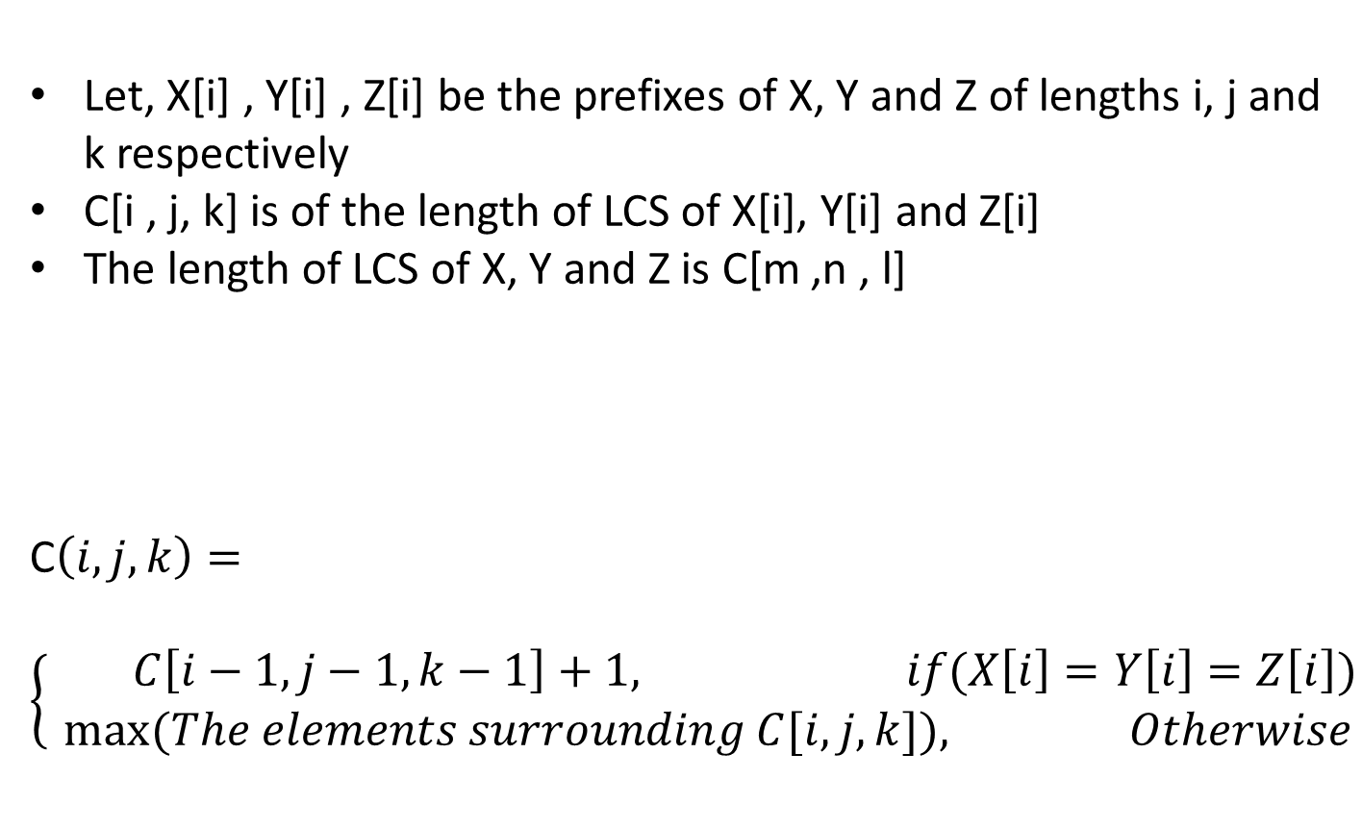
Longest Common Subsequence (3)
Let, X[i] , Y[i] , Z[i] be the prefixes of X, Y and Z of lengths i, j and k respectively
C[i , j, k] is of the length of LCS of X[i], Y[i] and Z[i]
The length of LCS of X, Y and Z is C[m ,n , l]
C$\left(i,j,k\right)=$
$$\left\{\begin{aligned} C\left[i−1,j−1,k−1\right]+1, if(X\left[i\right]=Y\left[i\right]=Z\left[i\right]) \\ &max⁡(The elements surrounding C[i,j,k]), Otherwise\end{aligned}\right.$$

Slide 3
Longest Common Subsequence (3)
All the elements surrounding it
The elements surrounding C[ i, j, k ] except C[i-1,j-1,k-1] are :
1.C[ i-1, j, k ]
2.C[ i, j-1, k ]
3.C[ i, j, k-1 ]
4.C[ i-1, j-1, k ]
5.C[ i, j-1, k-1 ]
6.C[ i-1, j, k-1 ]

Slide 4
Algorithm for LCS - 3
LCS-Length( X, Y, Z)
m=length(X)
n=length(Y)
l=length(Z)
//To consider special cases go to next slide
for i = 1 to m
for j = 1 to n
for k = 1 to l
if( X[i]==Y[i]==Z[i])
C[ i, j, k ]=C[ i-1, j-1, k-1 ]+1
else
C[ i, j, k ]=max(//All the elements surrounding it);
return C

Slide 5
Longest Common Subsequence (3)
Special cases:
1.For X[0], it means when the prefix of string X is empty
//Code start
for j=1 to n
for k=1 to l
C[ 0, j, k ]=0
//Code end
2.Similarly for Y[0]
3.Similarly for Z[0]
4.For X[0] and Y[0], it means the prefix of string Y and string Z are empty
//Code start
for k=1 to l
C[ 0, 0, k ]=0;
//Code end
5.Similarly for Y[0] and Z[0]
6.Similarly for X[0] and Z[0]

Slide 6
Longest Common Subsequence (3)
The Longest common subsequence will be
C[ m, n, l ]

